Slide 1
ME388F Final Presentation: MOC Order of Convergence
Braden Pecora

Slide 2
Code to Code Solution Verification

Slide 3
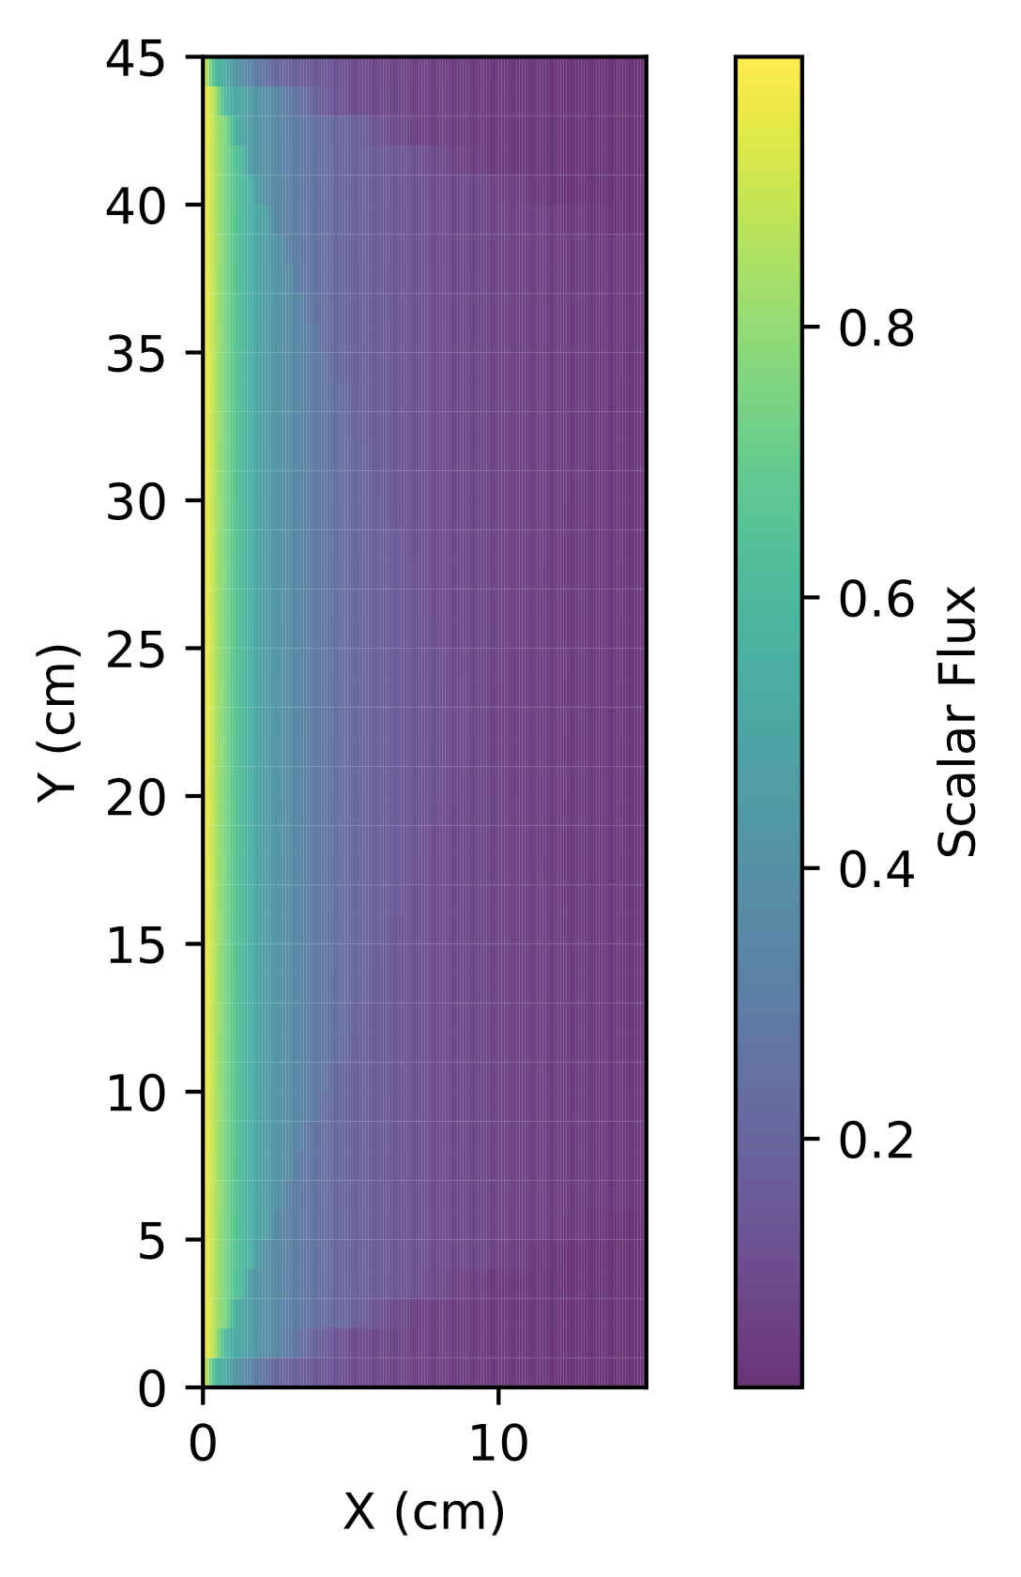
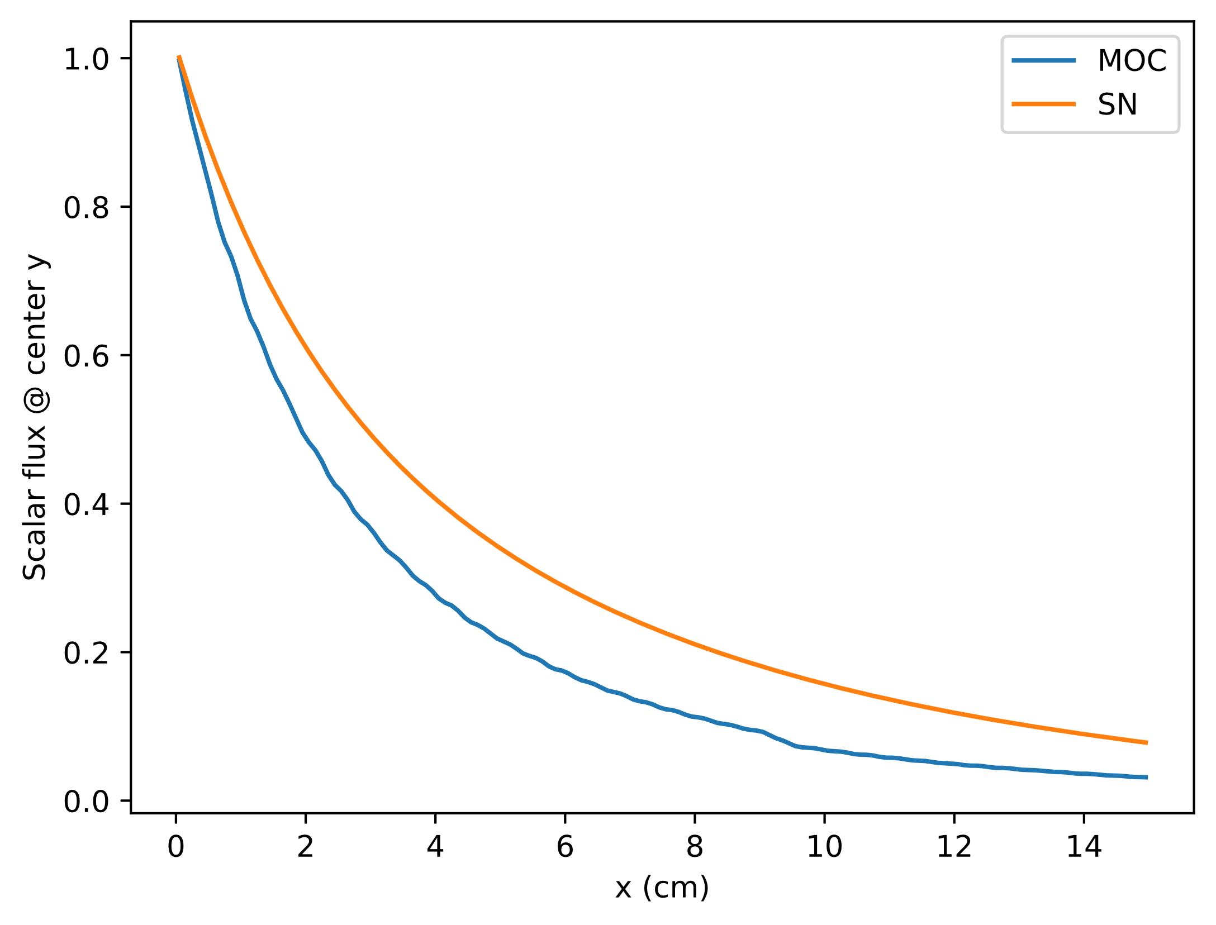
1D: Air

Slide 4
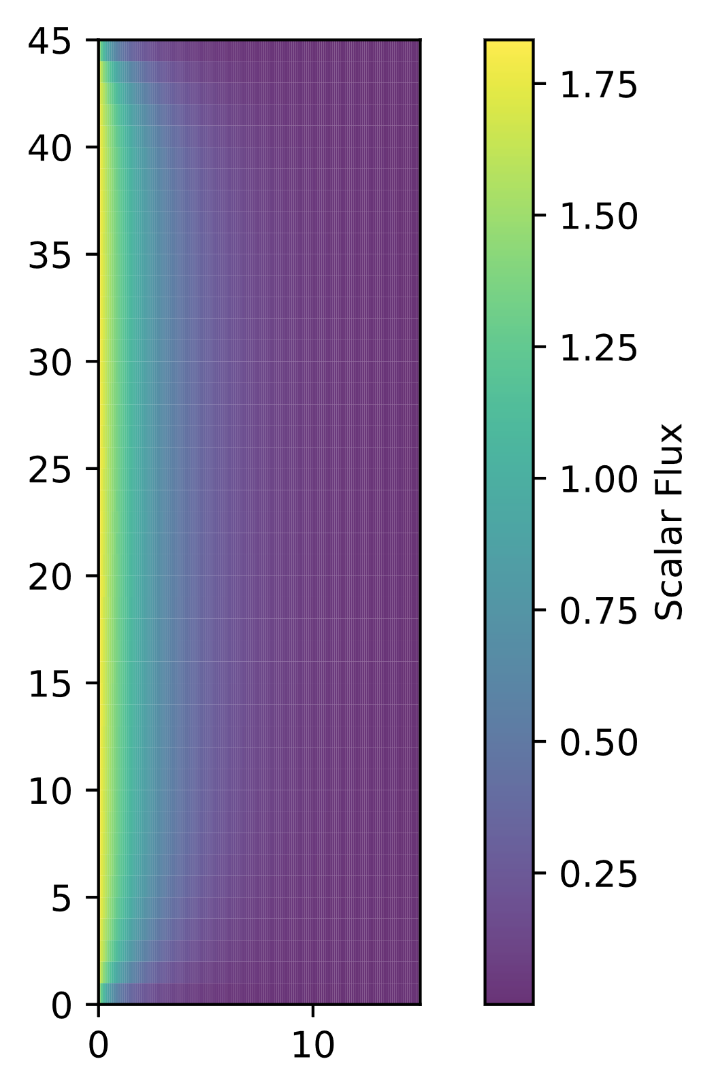
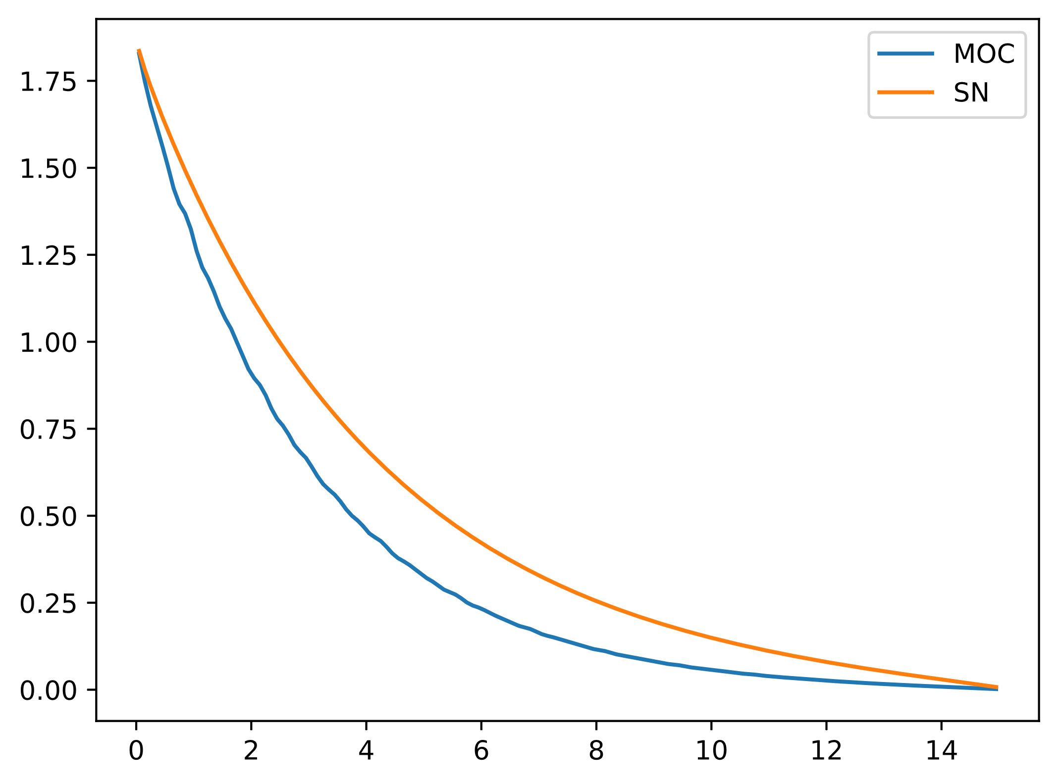
1D: Scatterer

Slide 5
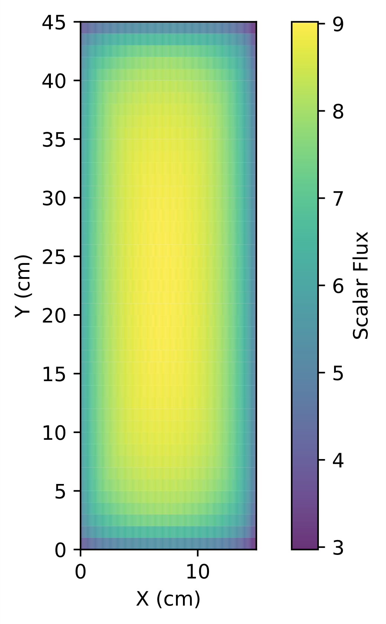
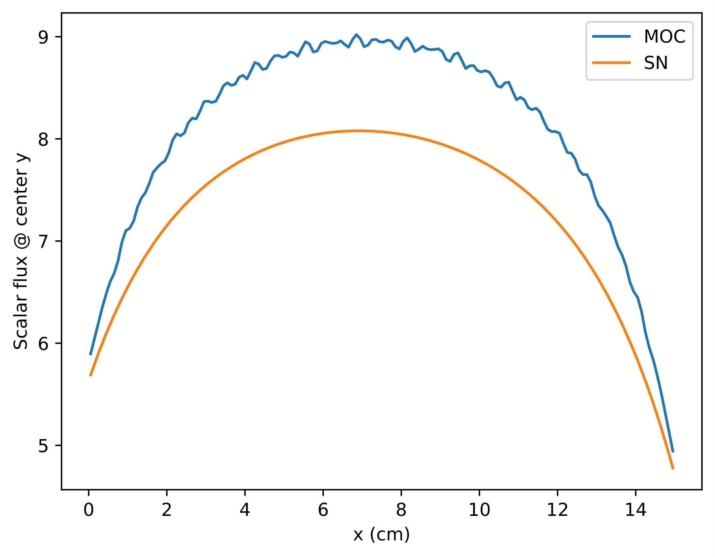
1D Isotropic Source

Slide 6
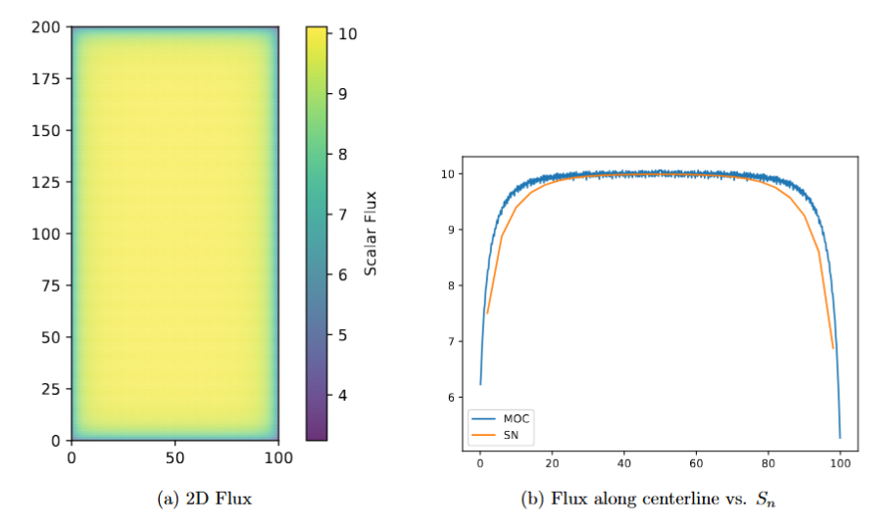
1D Isotropic Source

Slide 7
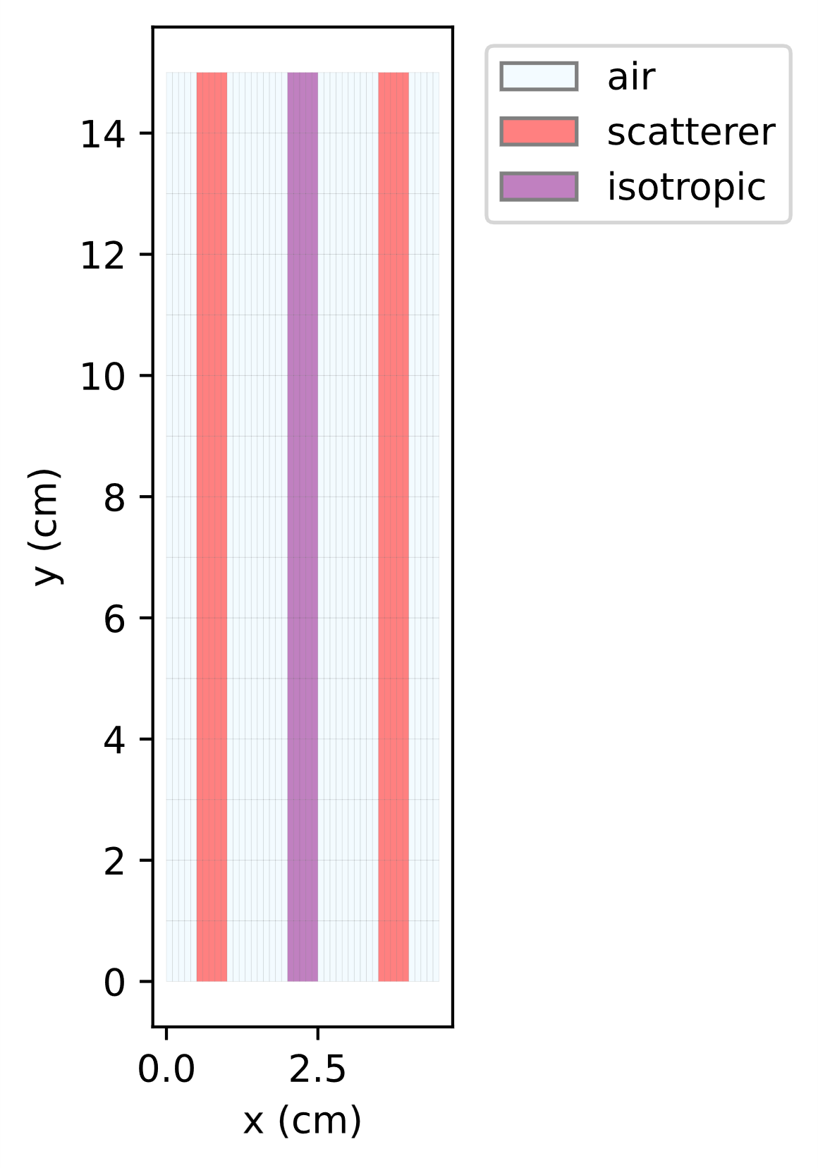
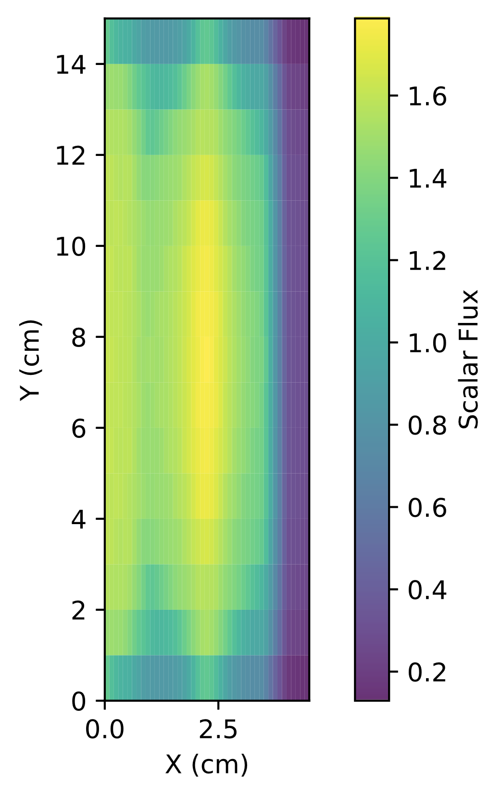
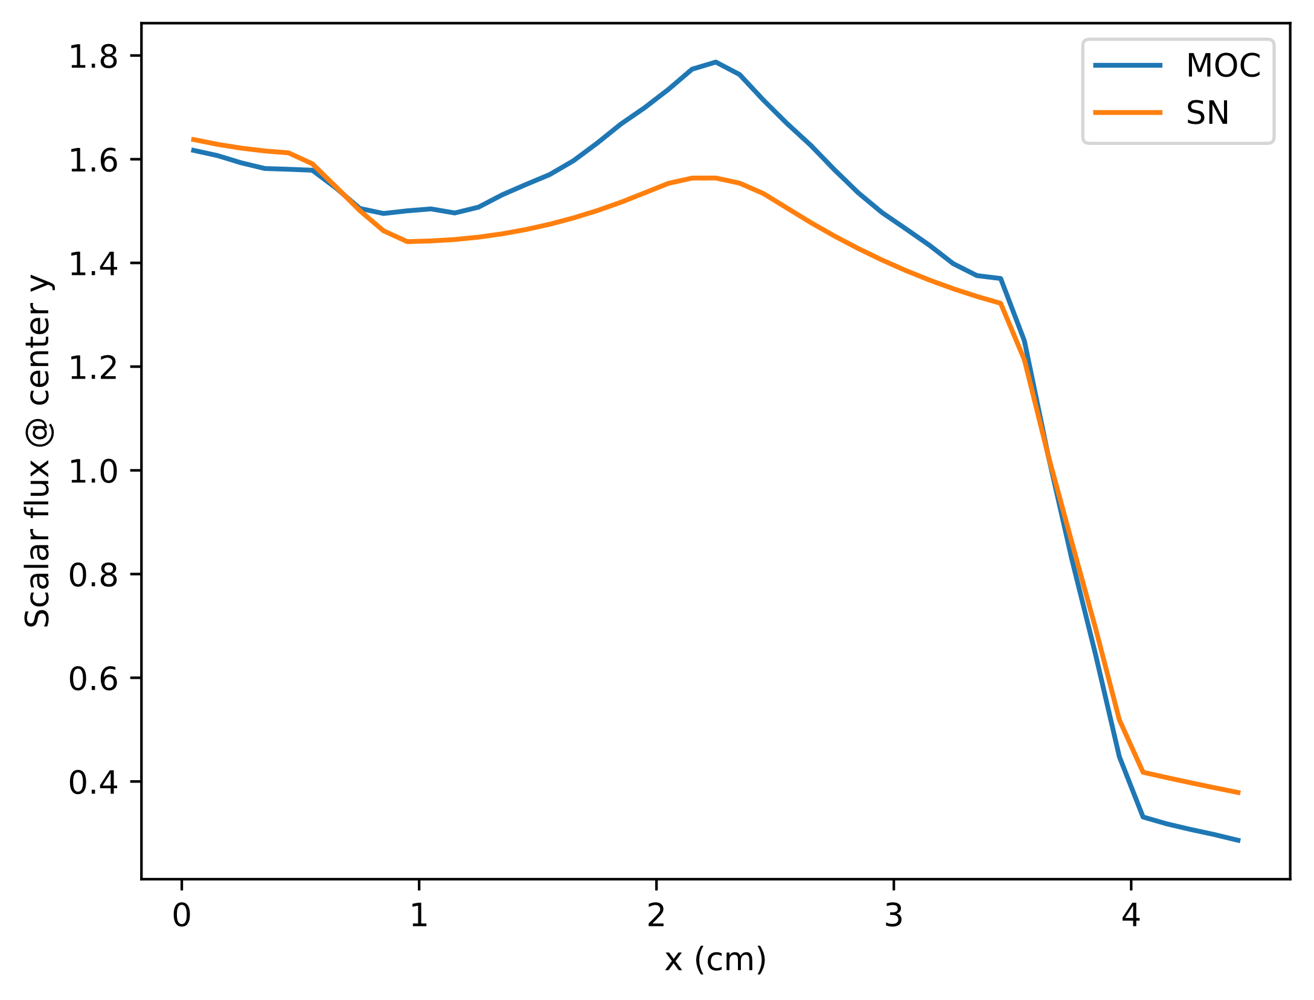
1D Varied Material

Slide 8
My 2D MOC code agrees somewhat well with my 1D Sn code
Shapes are mostly correct
Flux at left and right boundaries was pretty accurate
Expected symmetry
Potential room for improvement:
Reflecting boundary conditions
Increase size of Y domain
Problems calculating streaming?
Rays that hit corners of cells?

Slide 9
Order of Convergence

Slide 10
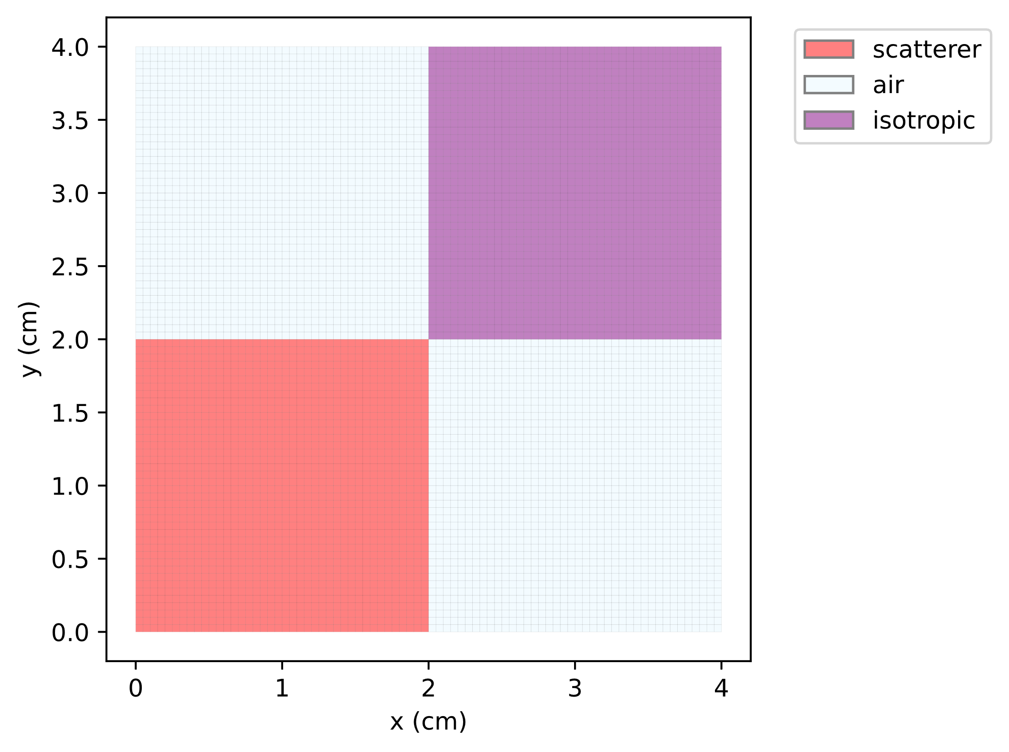
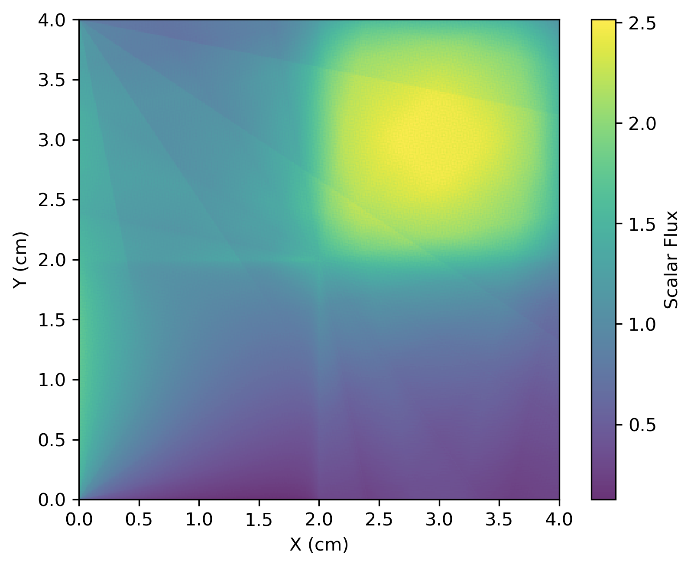
Initial Problem

Slide 11
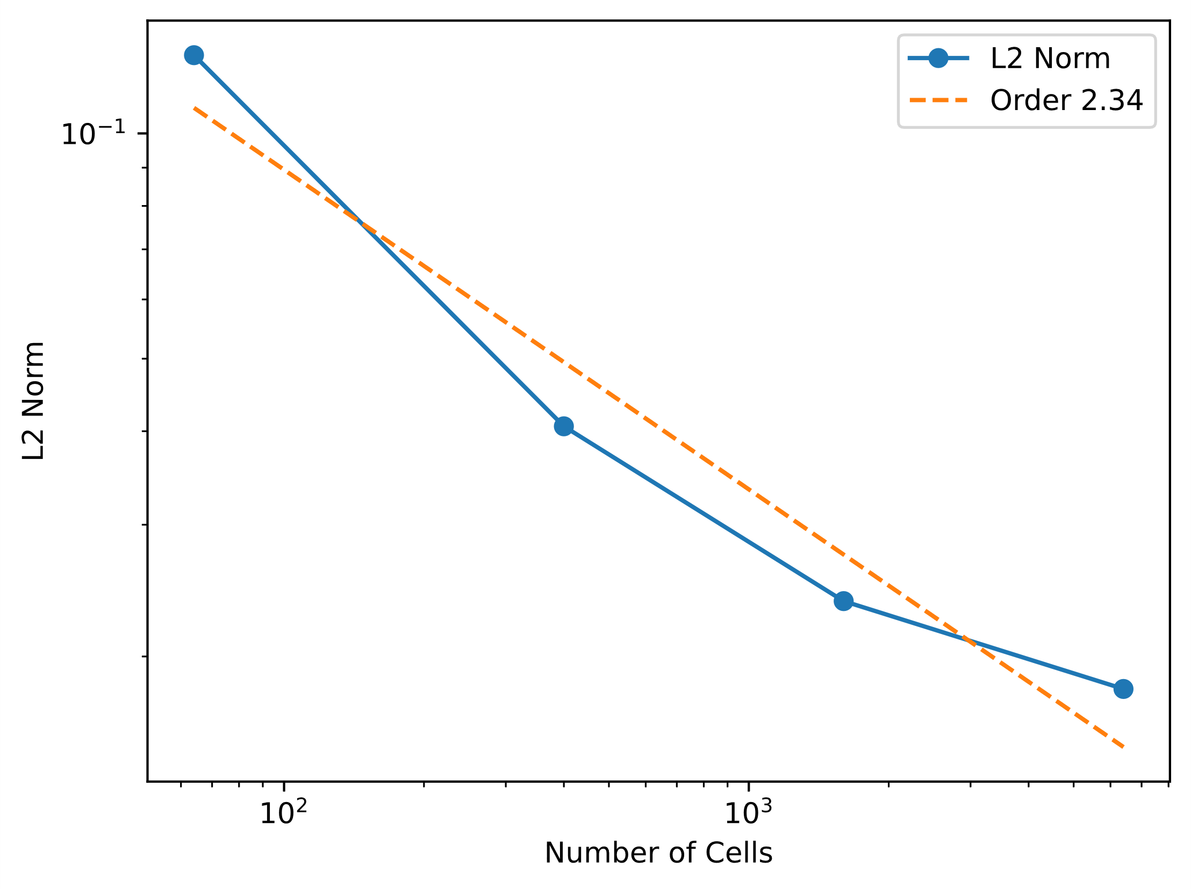
My code exhibits and order of convergence of approximately two with space
Started with 160,000 cells
8 Azimuthal and 4 Polar Angles
Base solution took ~25 minutes to solve
Potential sources of error
Issues with interpolation?
Dynamic ray widths?
Ray effects

Slide 12
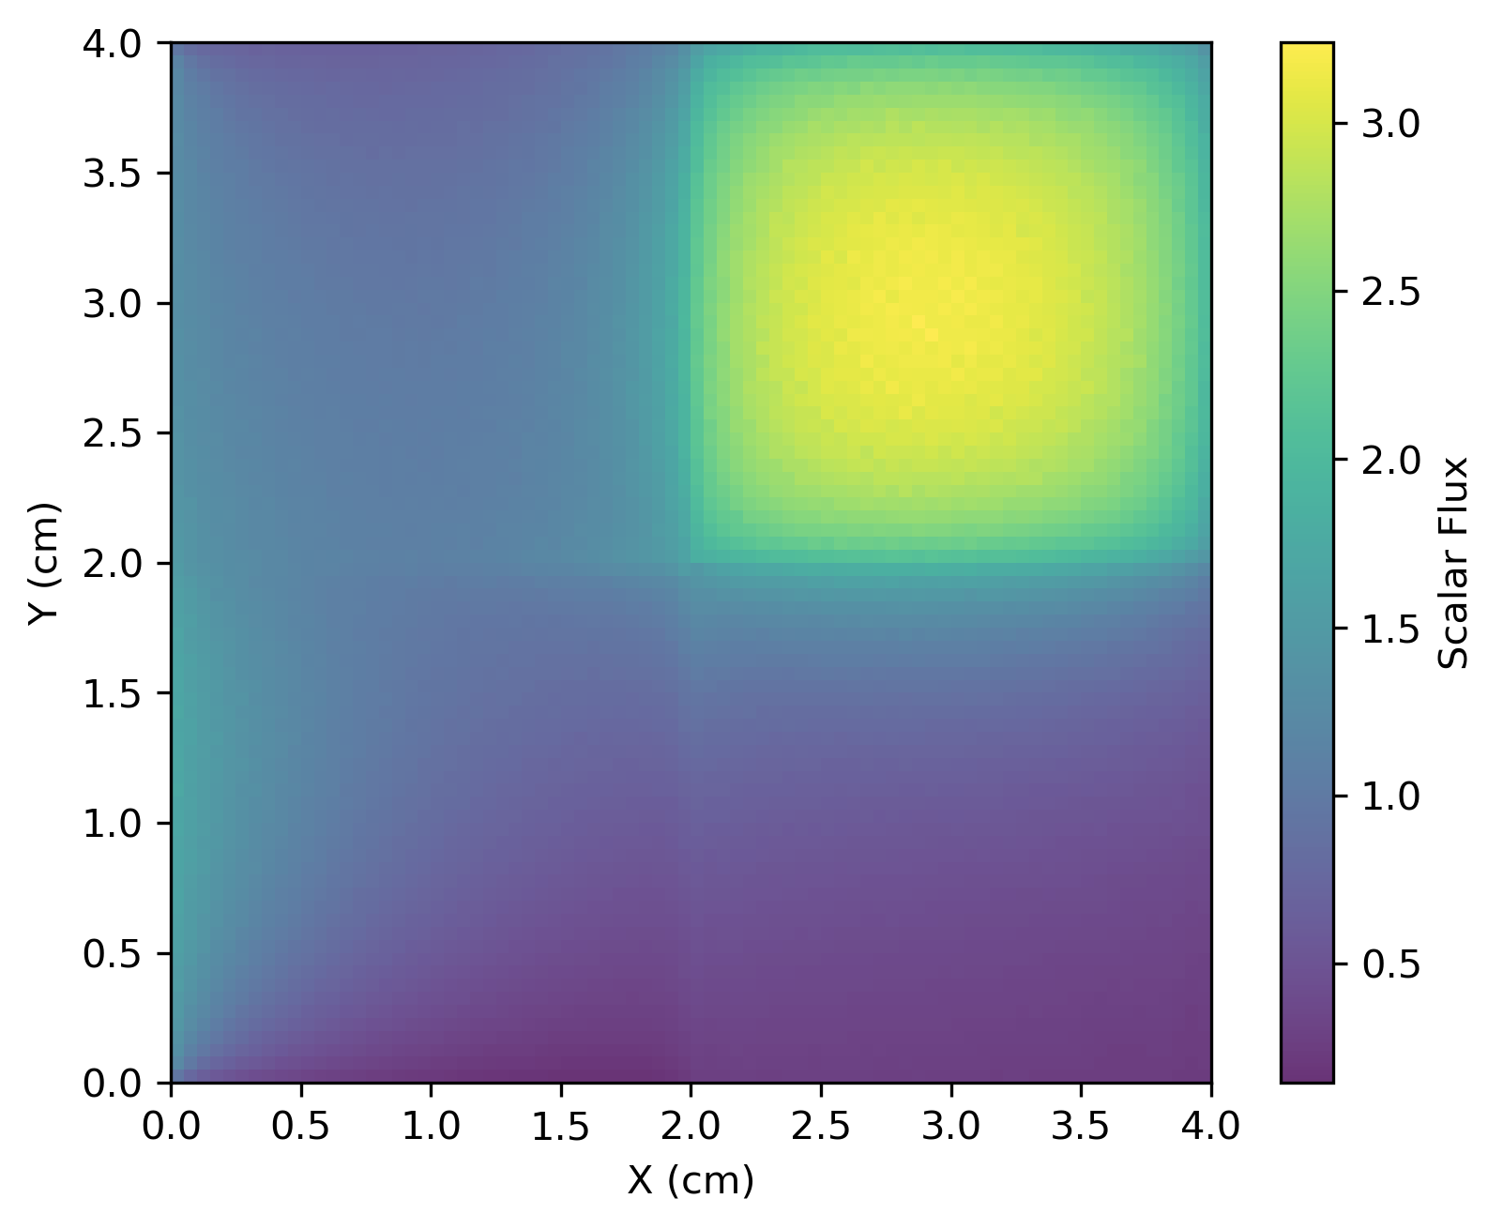
I used a coarser mesh with many angles as the ground truth for angular convergence
64,000 cells
64 azimuthal and 64 polar angles
Base solution took ~30 minutes to solve
No noticeable ray effects in truth
Varied number of azimuthal and polar angles independently

Slide 13
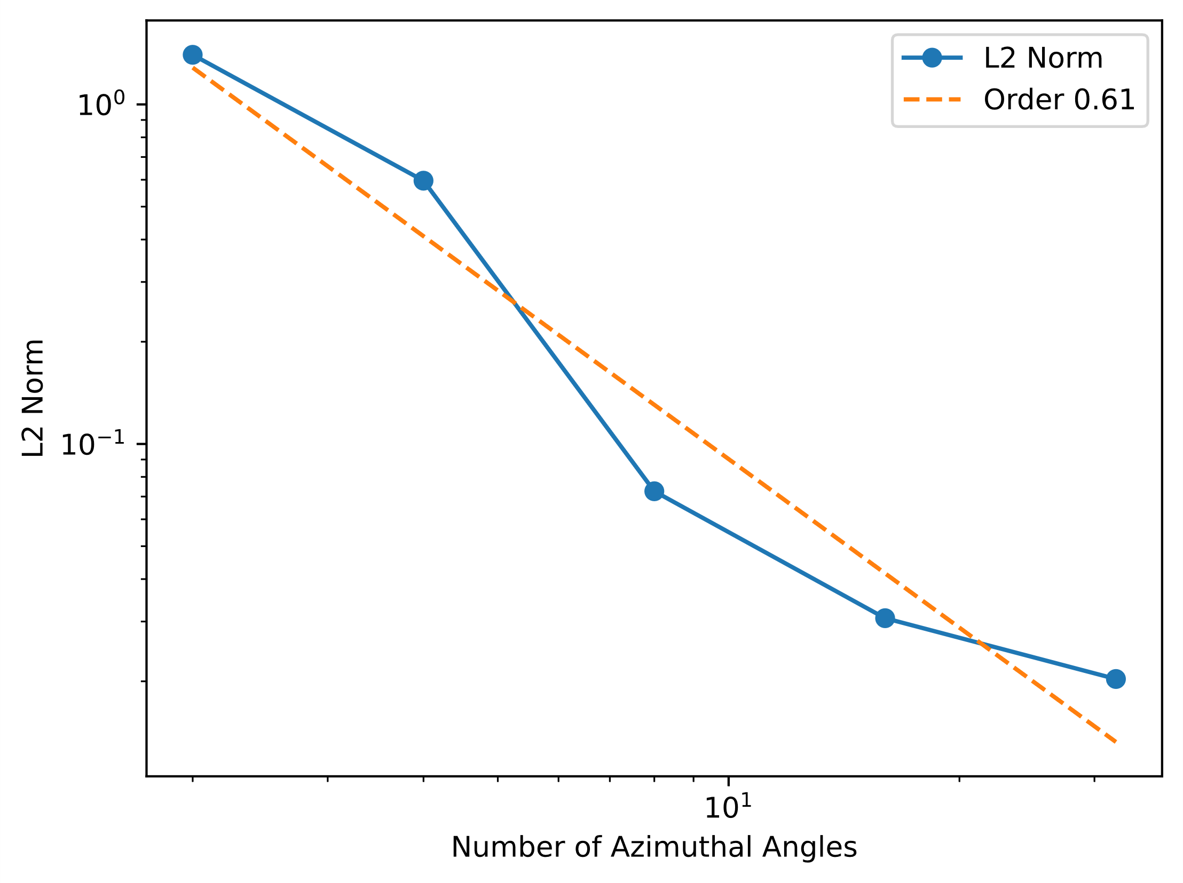
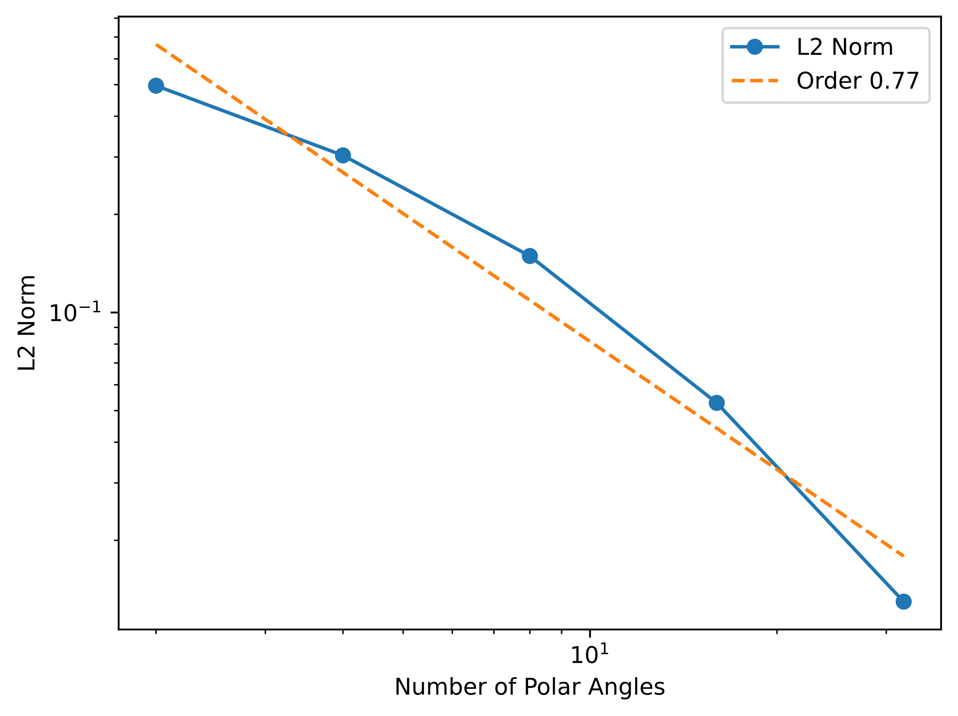
The order of convergence with each angle is approximately one

Slide 14
I tried many things to speed up my code
Pre-generate rays (Infinite speed up)
Threading on ray generation (major slow down to 4x speed up depending on the task)
Batch processing rays (3-4x speed up on ray generation)
Compiling the streaming calculation (10x speed boost on iteration)
Threading ray solves (no speed up)
Ask Copilot to speed up my code
Vectorization – no noticeable speed up
Avoiding repeating calculations (~2x speed boost)

Slide 15
Issues encountered
Shapely did not return intersecting cells in the right order so I had to calculate the order
Shapely has a lot of overhead (complicated geometry), but I think batching intersection calculations ended up saving me computational time
Initial fluxes were annoying (no reflecting boundary conditions)
Typos in the streaming calculation
Deep copies of objects for some libraries for threading
Running out of memory

